Slide 1
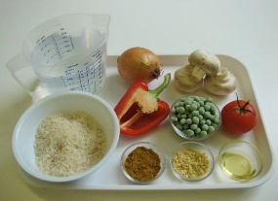
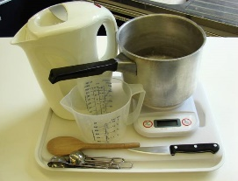
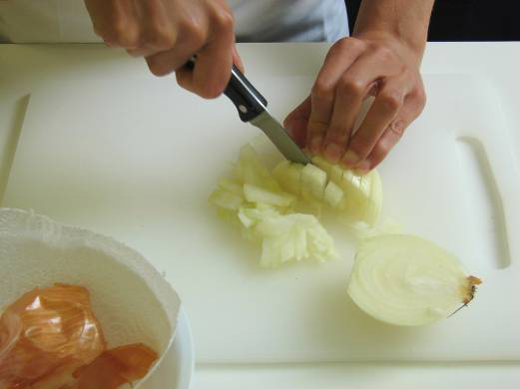
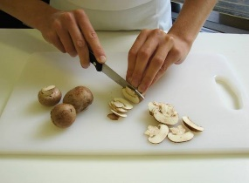
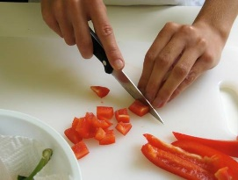
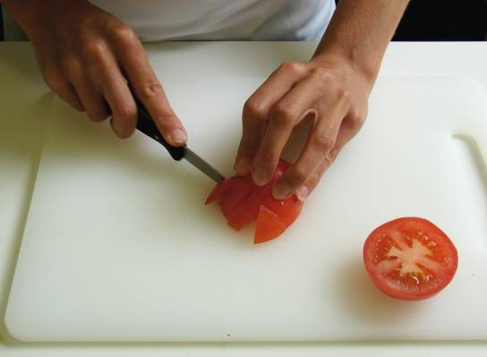
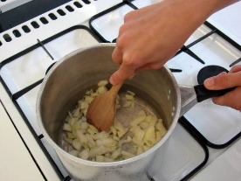
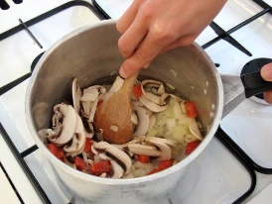
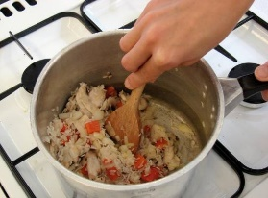
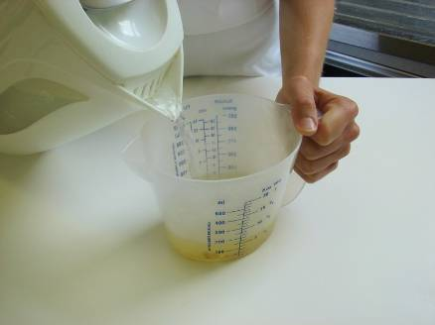
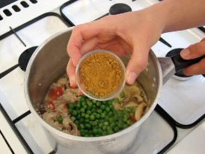
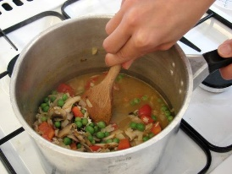
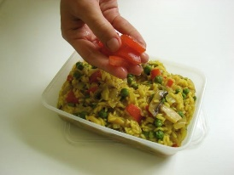
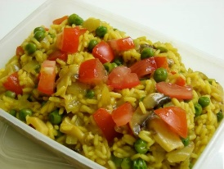
Savoury rice
Ingredients
1 onion
3 mushrooms
1/2 red pepper
1 tomato
1dsp oil
150g long grain rice
550ml water, boiling
1 teaspoon vegetable stock powder or cube
50g peas
1 dsp curry powder
Method
1. Prepare the vegetables:
peel and chop the onion;
slice the mushrooms;
dice the red pepper;
chop the tomato.
2. Fry the onion in oil until soft.
3. Add the mushrooms and red pepper and cook for a further 2 minutes.
4. Stir in the rice.
5. Mix the stock powder with the water.
6. Add the stock, peas and curry powder.
7. Simmer for 15 minutes, until the rice is tender.
8. To serve place the rice in a bowl and sprinkle the chopped tomato on top.
Equipment
Chopping board, knife, saucepan, wooden spoon, weighing scales, measuring jug, measuring spoons, kettle.
Safety rules:
Tie back long hair remove jewellery,
Put on a clean apron, wash hands.
Wash vegetables before use.
Use bridge and claw grip.
Attend frying pan at all times. Do not over heat oil.
Stir occasionally to avoid rice burning
Cool and chill, eat within 2 days.
Use your mind map to help to develop this recipe by changing fruit, veg, meat, sauces etc
SKILLS
Using the Hob, Weighing, Measuring, Bridge and claw, Using a kettle, Frying/simmering, Combining/mixing, Onion preparation

Slide 2
Evaluation
Follow up work
Evaluation of frittata (PMI)
Complete the table below with the Pluses (+) (good points), Minuses (-) (bad points) and Interesting points about your frittata
Iterations (Improvements) if you made this recipe again
Explain the changes that could be made to this recipe to make a different or better version of frittata.
_________________________________________________________________________________________________________________________________________________________________________________________________________________________________________________________________________________________________________________________________________________________________________________________________________________________________
 | Pluses (+) (Good) | Minuses (-) (Bad) | Interesting points
Appearance
Smell
Taste
Texture
Eatwell guide

