Slide 1
At the end of this lesson you will be able to:
Identify the different cooking methods (level 3-7)
Define some of the advantages and disadvantages of different cooking methods (Level 8- GCSE)
Keywords: Texture, taste, appearance, dry, moist, fry, nutrition

Slide 2
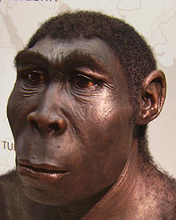
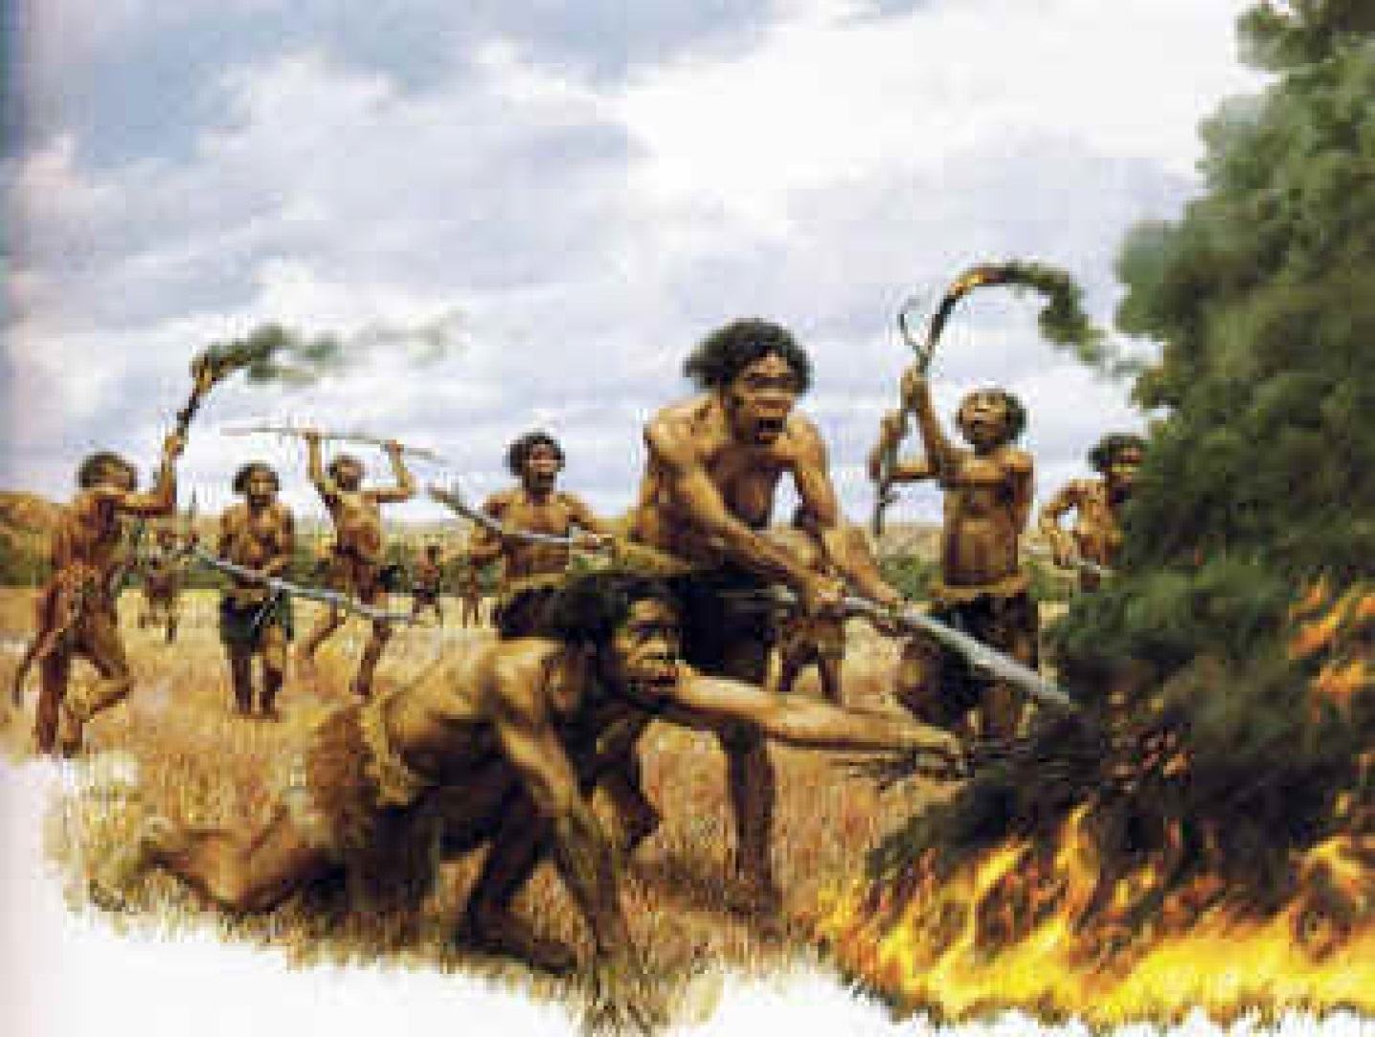
The control of fire by early humans was a turning point in the history…
WHY?

Slide 3
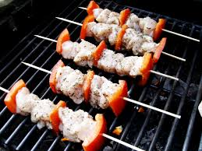
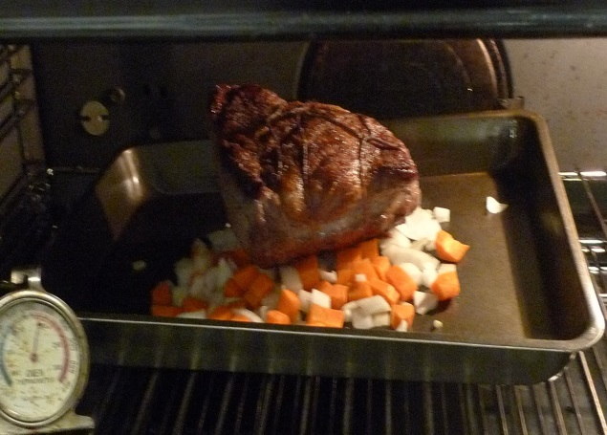
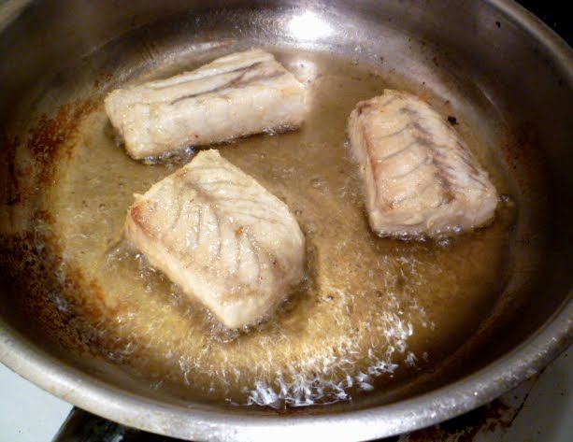
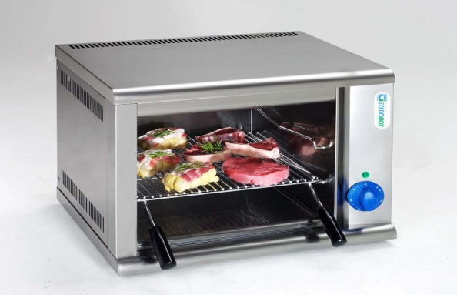
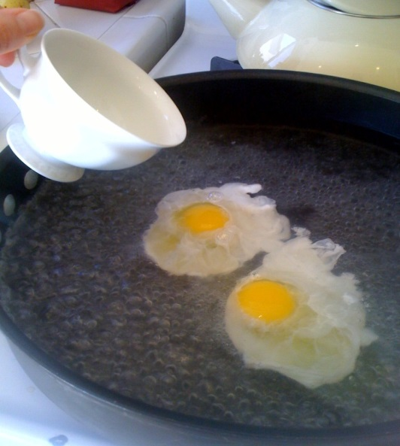
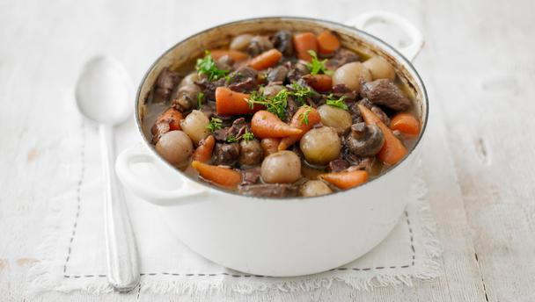
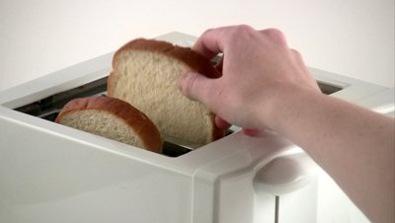
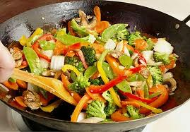
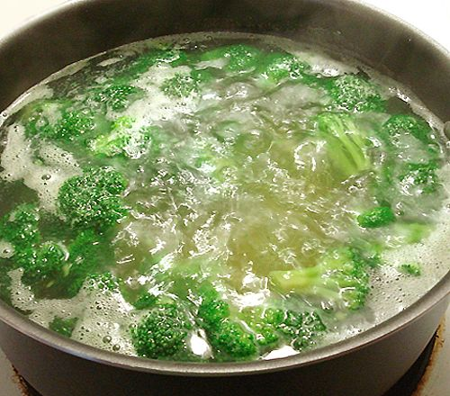
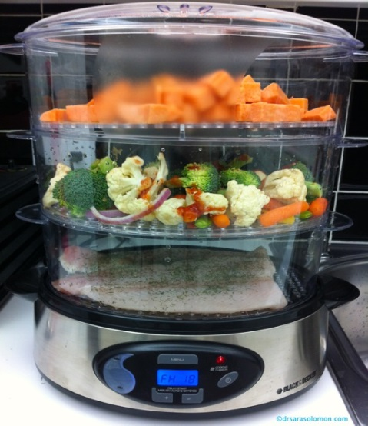
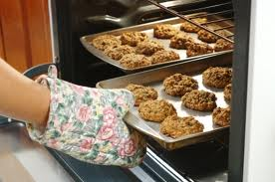
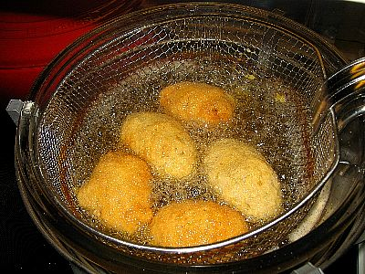

Slide 4
Cooking Methods
Advantages and disadvantages
Dry Heat | Moist Heat | Frying
Baking
This method of cooking for vegetables is very good as the food does not lose its …………. and most of the ……………are retained during the cooking. The name of this method is …………………
Food is frequently turned over to prevent it from ………… and to ensure that equal heating and cooking time is applied to both sides of the food. By doing this, the food is cooked …………… and thoroughly.
In …………. frying, food is cooked in a ……………… with a little amount of oil or fat.
The outer part of the meat is …… ……….frequently during the cooking process with the juice that is being spooned over.
Keywords to help you:
Evenly, vitamins, colour, taste, easy, quick , long time, burning , frying pan, shallow, steaming, moistened

Slide 5
Cooking Methods
Advantages and disadvantages
Dry Heat | Moist Heat | Frying
Baking | Steaming | Deep fat frying
Grilling | Boiling | Shallow frying
Roasting | Poaching | Stir frying
Barbequing | Stewing
Basting
This method of cooking for vegetables is very good as the food does not lose its taste and most of the vitamins are retained during the cooking. The name of this method is steaming.
Food is frequently turned over to prevent it from burning and to ensure that equal heating and cooking time is applied to both sides of the food. By doing this, the food is cooked evenly and thoroughly.
In shallow frying, food is cooked in a frying pan with a little amount of oil or fat.
The outer part of the meat is moistened frequently during the cooking process with the juice that is being spooned over.
Keywords to help you:
Healthy, vitamins, colour, taste, texture, easy, quick , long time, burning , frying pan, shallow, steaming, moistened

Slide 6
Can you identify the different cooking methods?
DRY MOIST FRY
To bake | To cook in an oven without any extra fat.
To roast | To cook, especially meat, in an oven or over a fire.
To boil | To cook food in boiling water that is 100° C
To fry | To cook food in hot oil, or fat.
To steam | To cook food by heating it in the steam made from boiling water.
To poach | To cook an item by submerging it in a liquid that is just barely simmering. (75° C / 85° C)
To toast | To cook or brown food, like bread or cheese by exposing it to a grill or fire.
To stir fry | To fry very quickly over high heat; "stir-fry the vegetables in a wok".
To BBQ | To cook food over charcoals on a grill.
To stew | To cook meat and vegetables slowly in liquid in a closed dish or pan.

Slide 7
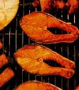
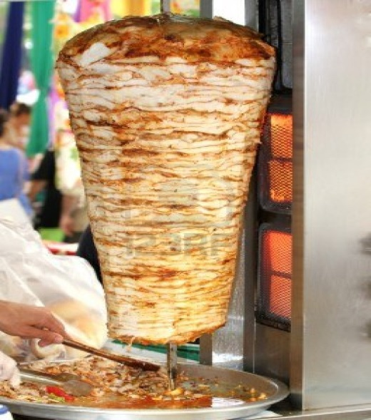
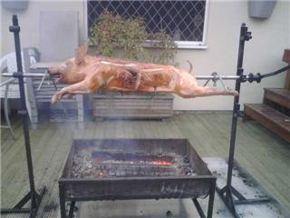
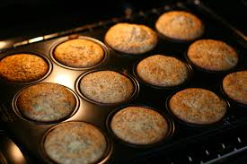
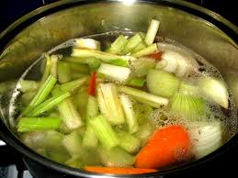
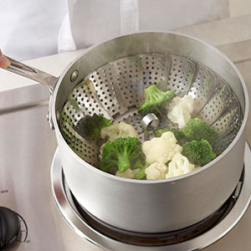
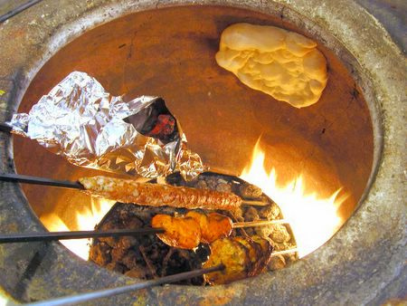
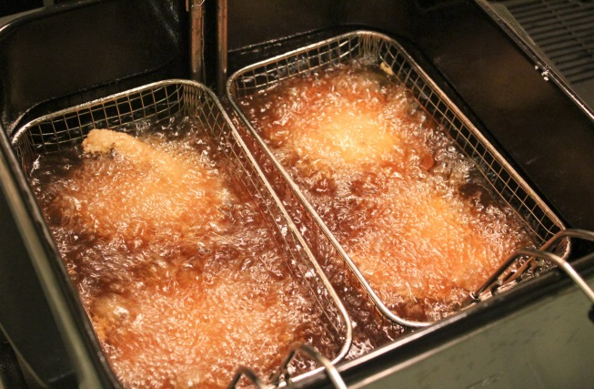
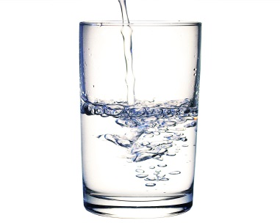
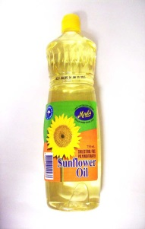
Can you group these pictures? Draw a line
DRY HEAT MOIST HEAT FRY

Slide 8
Hands up ……
If you can name 3 different cooking methods and categorise them correctly?
If you can name 5 or more different cooking methods and categorise them correctly?

