Slide 1
Nutrients – Match up

Slide 2
What is a balanced diet?
This means eating a variety of foods each day, including foods from each of the four main food groups shown in the table below:
Food type | Portions
Meat and meat alternatives | 2 portions
Milk and other dairy products | 3 portions
Fruit and vegetables | 5 portions
Potatoes and other starchy foods | 5-6 portions

Slide 3
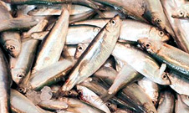
Proteins
Proteins assist with growth and repair of the body.
Proteins are found in animal products like meat, fish, cheese, milk and eggs. Vegetable sources include soya-bean products, pulses and nuts.

Slide 4
Carbohydrates
Carbohydrates are needed to give the body energy. There are two types of carbohydrate - starch and sugar.
Starch is found in cereals, cornflour, potatoes, pasta and flour.
Sugar is found in fruit, vegetables, honey, milk and malt products.

Slide 5
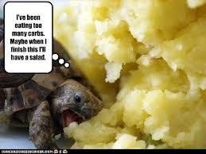
What happens if we eat too many carbohydrates:
Excess sugar is stored in muscle cells (to be ready for action) and in the liver.
Unfortunately, if it is not used then it is then stored as body fat.

Slide 6
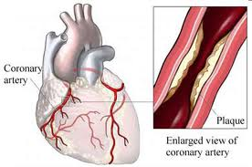
Fats
Fats help to provide concentrated sources of energy and help to insulate the body in cold weather.
However too much fat can cause:
Obesity
High cholesterol
Coronary heart disease (CHD)
Halatosis (bad breath)
Type 2 diabetes

Slide 7
Vitamins
Vitamins are needed in very small amounts for growth and health. The main vitamins are vitamin A, the B complex of vitamins, vitamin C and vitamin D

Slide 8
Vital for good health
Vitamin | Need for | Sources
Vitamin A | - good vision - healthy skin - growth | - green and yellow vegetables - dairy products
Vitamin B (thiamin, riboflavin and niacin) | - release of energy from foods - healthy skin | - breads - milk - eggs
Vitamin B12 | - red blood cells | - meat - milk - fish
Vitamin C | - healthy skin - protects cells - helps absorb iron | - fruit - vegetables
Vitamin D | - helps absorb calcium - strong teeth and bones | - margarine - oily fish - sun

Slide 9
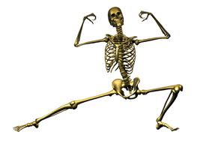
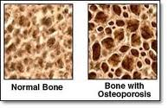
Minerals
Minerals are needed in small amounts to help the body function properly and stay strong. Calcium and iron are two important minerals.
Calcium
Calcium is needed for the growth of healthy teeth and bones. Sources of calcium include milk, cheese, eggs, wholegrain cereals, green vegetables, bread and tofu.
Lack of calcium can lead to osteoporosis (brittle bone disease)
Iron
Iron is needed for the formation of red blood cells. Sources of iron include red meat, green vegetables, eggs, lentils and bread.

Slide 10
Quick test – class knowledge
1. What is the function of proteins in the body?
They are needed for digestion. They needed for energy. They are needed for growth and repair of the body.
2. What food is a good source of protein?
Potatoes Sugar Eggs
3. What is the function of carbohydrates in the body?
They are needed for digestion. They needed for energy. They are needed for growth and repair of the body.
4. What are starch and sugar types of?
Fat Vitamin Carbohydrate
5. Which type of fat comes from an animal source?
Unsaturated Saturated Dissaturated
6. What food is a good source of fat?
Butter Vegetables Bread
7. What food is a good source of vitamin C?
Bread Oily fish Fruit
8. What is the function of vitamin D in the body?
Energy Formation of red blood cells Strong teeth
9. What is the function of iron in the body?
Energy Formation of red blood cells Strong teeth
10. What food is a good source of calcium?
Milk Meat Sugar

Slide 11
Drag and drop into the sections of the eatwell plate

Slide 12
Activity
______________ is not a nutrient but is needed for healthy bowels and to avoid constipation. Blood needs ______________ to make red blood cells, which carry oxygen around the body to where it is needed.
Muscles in the body need ______________ for work and physical activity.
______________ helps the body burn up energy foods.
Teeth need ______________ and ______________.
Two thirds of your body weight is ______________. It helps your body function properly.
Eyes need ______________.
Bones need ______________ and ______________.
Every cell of the body needs ______________ for growth and repair.
The cells of the body must be help together. Body cells need ______________ to be able to do this.
______________ is also needed to prevent illness.
______________ keeps the body warm and gives us energy. Too much ______________ can cause obesity.

Slide 13
Exam questions
Milk and milk products form a large part of our diet.
Name 2 nutrients found in milk ( 2 marks)
Describe the types of milk available and explain how they meet the needs of a caterer. (6 marks)
EATING TOO MUCH FAT CAN CAUSE OBISITY
State two risks to health caused by excess fat in the diet (2 marks)

Slide 14
Discuss how chefs can reduce the amount of fat in the dishes they produce (4 marks)
Explain other nutritional factors that chefs should consider when producing healthier dishes (5 marks)
The government guidelines suggest that we should all eat a healthy diet.
Explain what is meant by a healthy diet (3 marks)
Discuss how a restaurant can make the dishes they offer healthy (6 marks)

