Slide 1
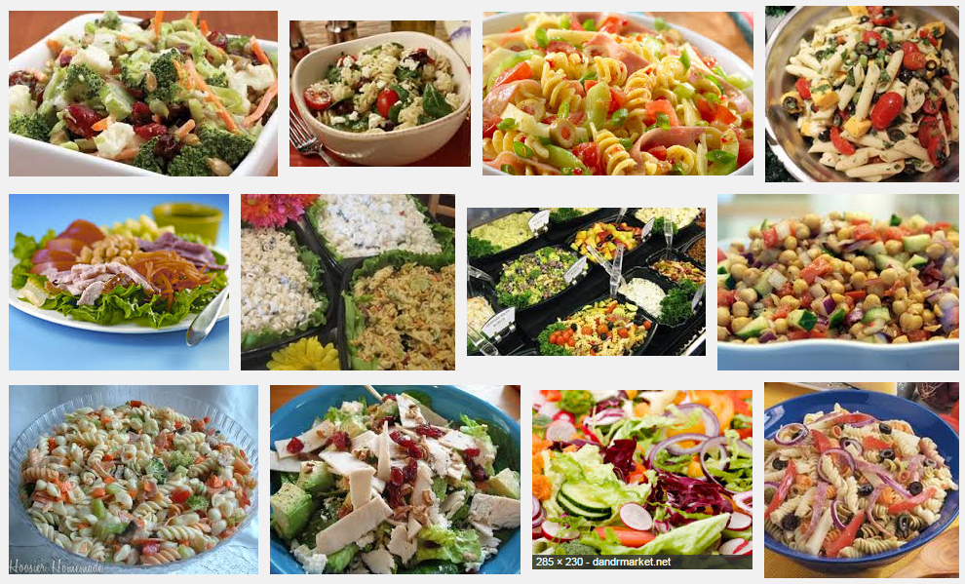
Deli salad ideas

Slide 2
Preparing for practical
Homework: Prepare for practical by bringing ingredients, leakproof bowl , clean apron and tea towel.
Ideas:
Cucumber
Tomatoes
Peppers
Olives
Mange tout
Carrot
Lettuce
Basil
Chives
Cheese
Dried tomatoes
Dressing ingredients can be bought for 20p

