Slide 1
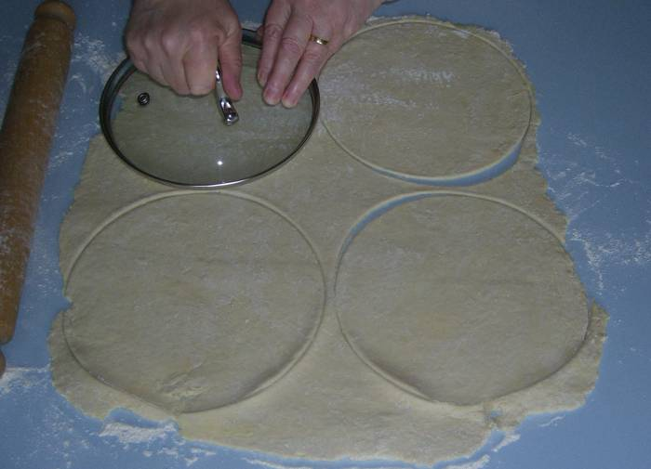
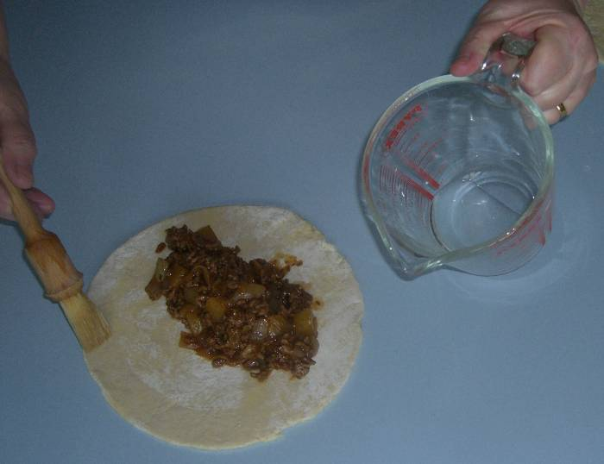
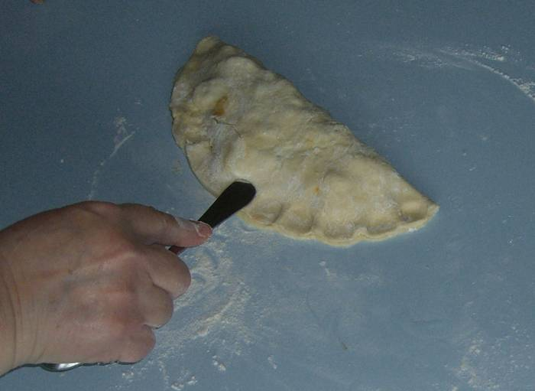
Cornish Pasty Recipe Card
Ingredients Required
Pastry
140g Plain flour
70g butter
4 tbsp. cold water
Filling:
60g potato
60g swede
60g onion
100g beef stew cuts
1 egg 1 tbsp. plain flour
Method
For the pastry: sieve the flour into a large mixing bowl and cut the butter up into cubes- rub the flour and butter together to create fine breadcrumbs. Add 2 tbsp. of cold water and using a palette knife combine to create a dough (add more water if required) leave to chill in fridge whilst making the filling.
For the filling: heat up a saucepan and add a small amount of oil. Prepare the vegetables into small cubes on a green chopping board.
Cut up the meat into small cubes. Add all the veg and meat to the saucepan and season with pepper. Cook for 5 minutes.
When juices start to seep add the tbsp. of flour into the saucepan and cook for a further 5 minutes. Turn off the heat.
Take the pastry out of the fridge and roll out on a floured work top into a circle about 0.5cm thick. Get a small saucer, place on the dough and cut around to create a circle shape.
Pour approximately 1 to 2 teaspoons of the filling covering less than half the circle. Fold the other half of the circle over and press the joined edges with a fork. You should now have half a moon shape. Prick the pasties with a fork (2 to 3 times) to allow the steam to release. Flute the edges with fingers and thumb or using a rounded spoon handle. Coat with a beaten egg using a pastry brush
Place in a pre-heated oven (180 C / Gas 4) for about 20 to 30 minutes
Equipment
Mixing bowl
Saucepan (deep)
Chopping board (1 green/1 red)
Chopping knife
Fork
Palette knife
Baking tray
Pastry brush
Jug/small bowl

