Slide 1
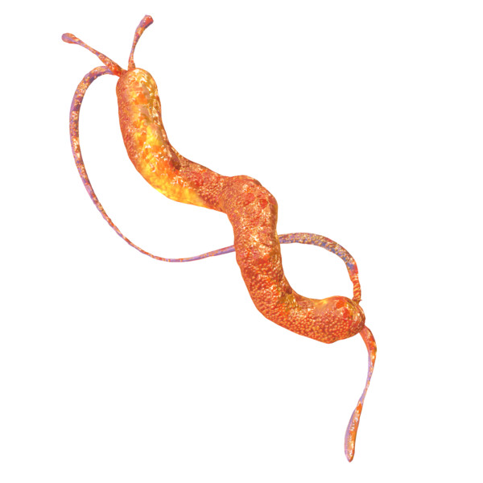
Types of Bacteria
E
Campylobacter
cam·pylo·bac·ter
meaning "twisted bacteria"
Found in raw poultry and meat.
Illness caused by small numbers of bacteria.
Symptoms:
Fever
Headache
Abdominal pain
Diarrhoea
Can last for 10 days

Slide 2
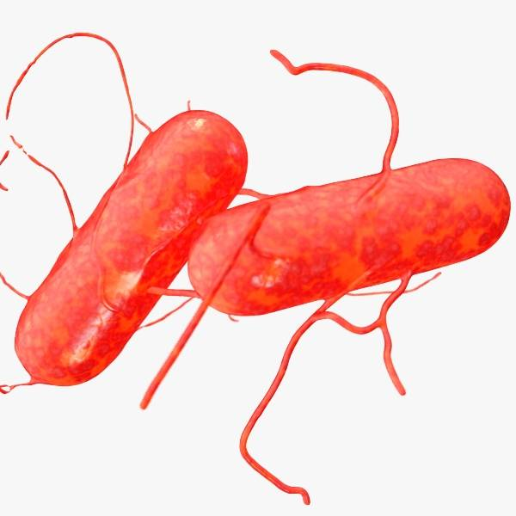
Types of Bacteria
E
Salmonella
sal·mo·nel·la
rod-shaped
Found in raw meat, unwashed vegetables, poultry and eggs.
2nd most common cause of food poisoning.
Survives refrigeration.
Illness caused by large numbers of bacteria.
Symptoms:
Fever
Diarrhoea
Vomiting
Abdominal pain
Can be fatal!
Can take up to 48 hrs. for symptoms to show
Can last for 3 wks.

Slide 3
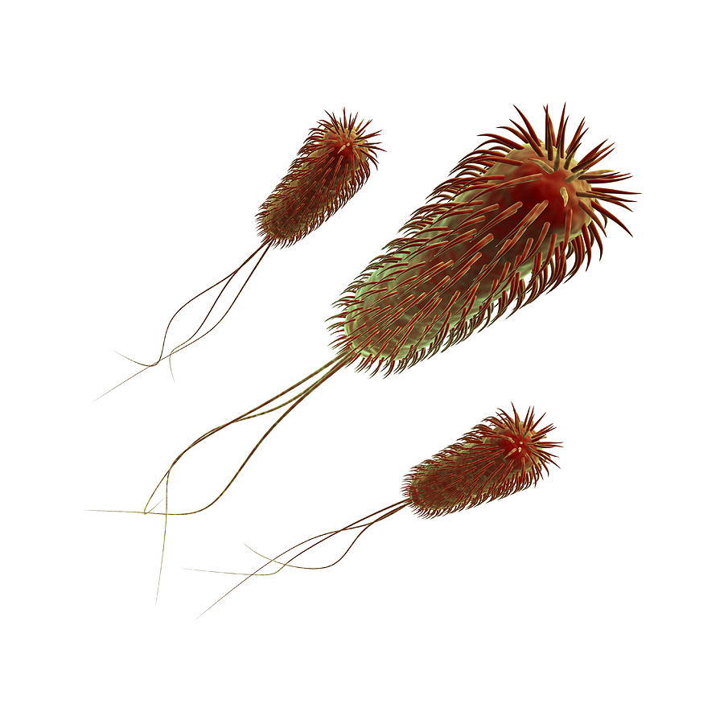
Types of Bacteria
E
E. Coli 0157:H7
e co·li
rod-shaped
Found in the gut of animals and humans.
E Coli 0157 is found in raw & undercooked meats, raw vegetables.
Illness caused by small numbers of bacteria.
Can survive refrigeration and freezing.
Symptoms:
Diarrhoea
Can be fatal
Can take up to 5 days for symptoms to show

Slide 4
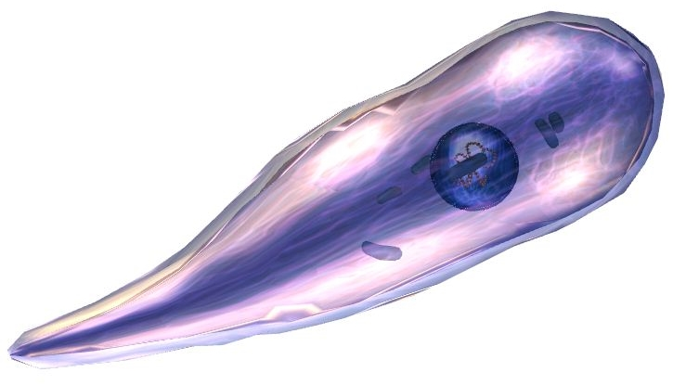
Types of Bacteria
E
Clostridium Perfringens
clos·trid·i·um per·frin·gens
rod-shaped
From animal poo!
Found in soil, manure, sewage, raw meat & poultry.
Produces spores which may not be killed by cooking.
Symptoms:
Abdominal pain
Diarrhoea
Nausea
Can be fatal
Onset normally after 8–18 hrs.

Slide 5
Types of Bacteria
E
Clostridium Botulinum
clos·trid·i·um bot·u·li·num
rod-shaped
Found in soil and root vegetables.
Symptoms:
Difficulties in swallowing, talking and breathing.
Double Vision
Paralysis of the cranial nerves.
Fatalities are common and recovery may take several months.
Onset between 12 to 36hrs.

Slide 6
Types of Bacteria
E
Clostridium Botulinum
clos·trid·i·um bot·u·li·num
rod-shaped

Slide 7
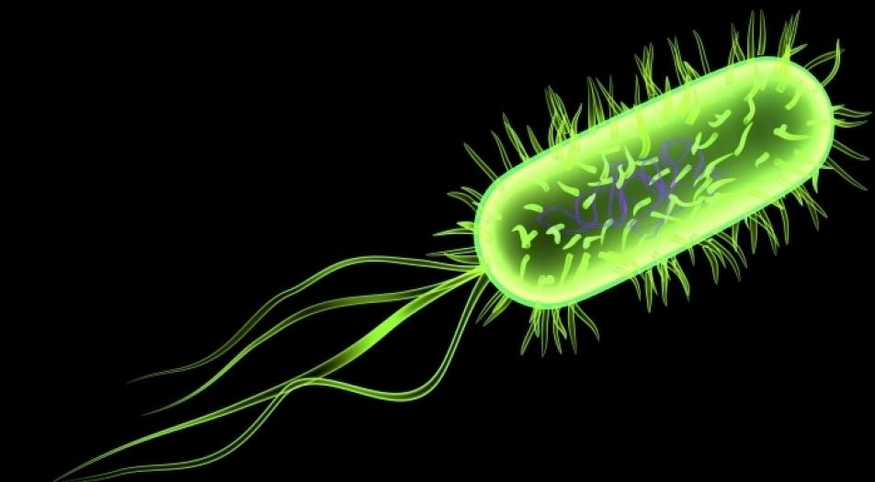
Types of Bacteria
E
Listeria
lis·te·ri·a
rod-shaped
Found in soil, vegetation, meat, poultry, soft cheese, salad vegetables.
Can grow at low temperatures.
Symptoms:
Range from flu-like symptoms to meningitis
Pregnant women, the very old and the very young are most at risk
Can take up to weeks to develop

Slide 8
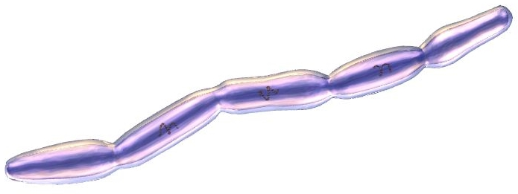
Types of Bacteria
E
Bacillus Cereus
ba·cil·lus ce·re·us
rod-shaped/cylindrical
Found in soil and dust.
Frequently in rice dishes & sometime in pasta, meat or vegetable dishes.
Illness can be caused by a small number of bacteria.
Forms spores that are resistant to heat.
Symptoms:
2 types of illness:
- diarrhoea and abdominal pain after 8 – 18 hrs.
- vomiting after 1 – 5 hrs.
Usually lasts less than 24 hrs.

Slide 9
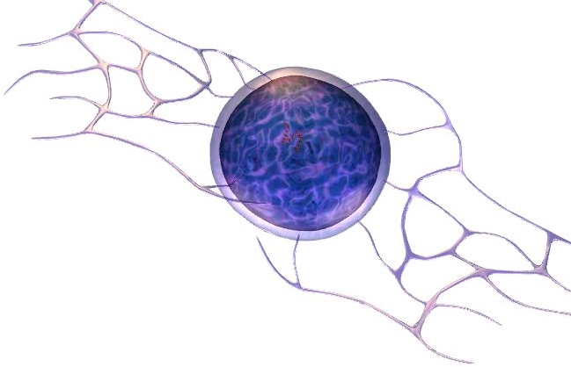
Types of Bacteria
E
Staphylococcus Aureus
staph·y·lo·coc·cus au·re·us
spherical
Found on the skin, in cuts and boils and up the nose!
Transferred to food from hands, nose or mouth.
Large numbers needed to cause illness.
Survives refrigeration.
Produces a toxin which may survive cooking.
Symptoms:
Severe vomiting
Abdominal pains
Diarrhoea
Onset within 6 hrs.
Lasts about 2 days

