Slide 1
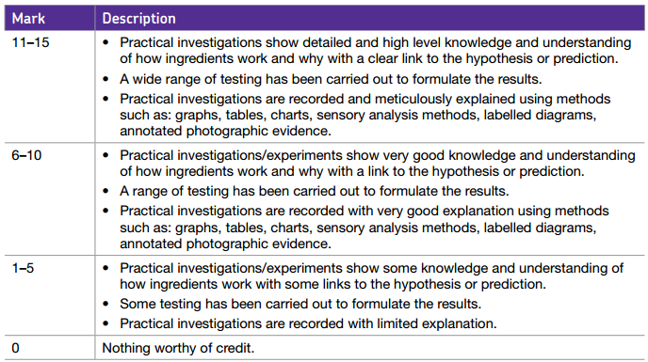
Learning Objectives- SECTION B: INVESTIGATION Carry out practical investigations, related to the hypothesis or prediction, which demonstrate understanding of how ingredients work and why. Record the results of the practical investigation. Investigate and evaluate how ingredients work and why through practical experimentation. Give a clear aim to the investigation Use a range of appropriate testing methods
 | Personalisation Special attention today goes to…
15

Slide 2
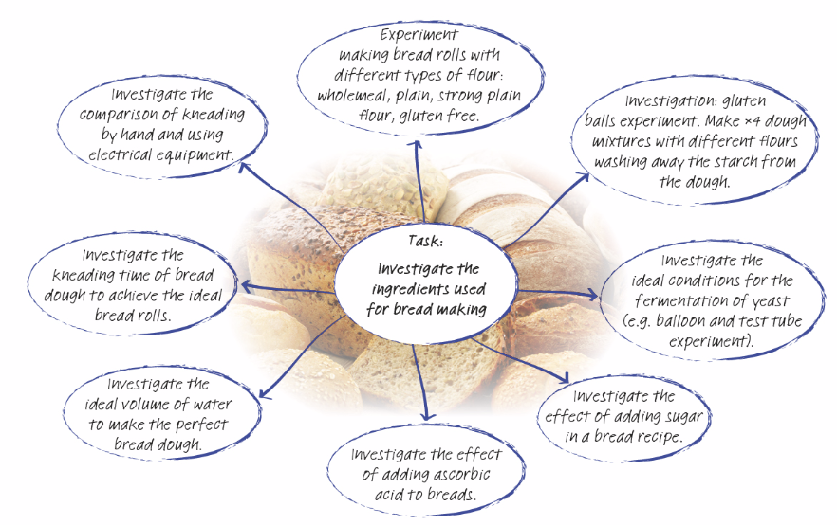
Section B: Investigation
For section B you have to carry out the experimental and investigation work to prove or disprove your hypothesis or prediction. Remember you should try to do 3 relevant investigations.

Slide 3
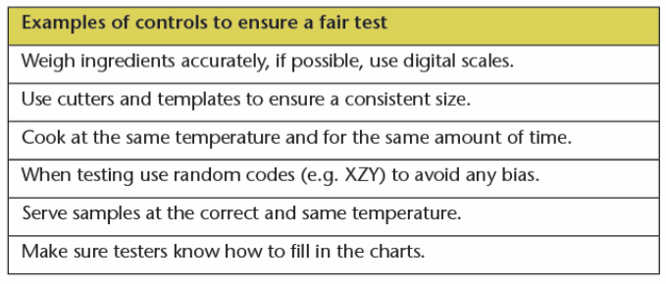
Section B: Investigation
Each investigation should have a clear aim written at the top of plan:
Example:
Aim: To experiment making bread rolls with different types of flours (wholemeal, plain flour, strong plain flour and granary flour) to find which flour creates an elastic texture and the effects on taste and appearance.
You should then list all the ingredients (with measurements/weights) that you will use for the investigation.
You then need to decide upon the method for your investigation – so explaining how will you carry it out so that it is fair. List what you are doing and how.

Slide 4
Section B: Investigation
Fair Testing Examples

Slide 5
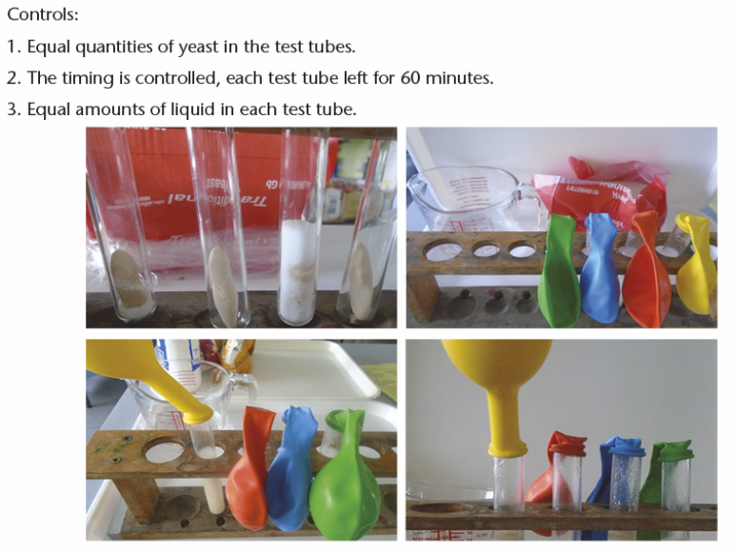
Section B: Investigation
Fair Testing Examples

Slide 6
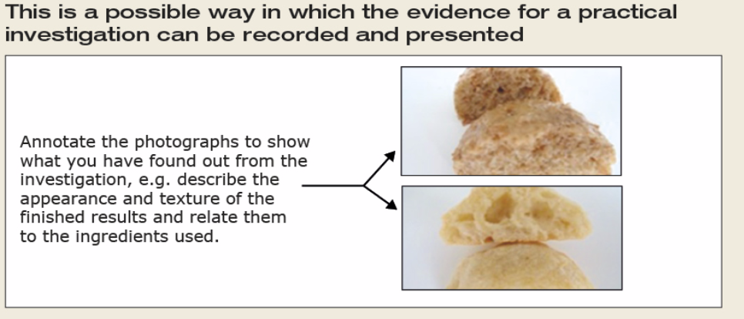
Section B: Investigation – Recording Results
Practical and Recording Results
Make sure that you have set up any tables, graphs, labels and diagrams before you start the practical ready for when you come to evaluate the results.
Take lots of photos!
Include your candidate name and number

Slide 7
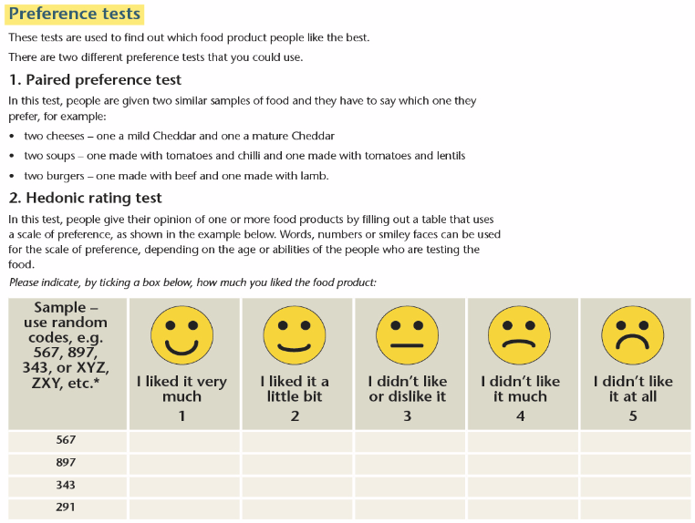
Section B: Recording results - testing

Slide 8
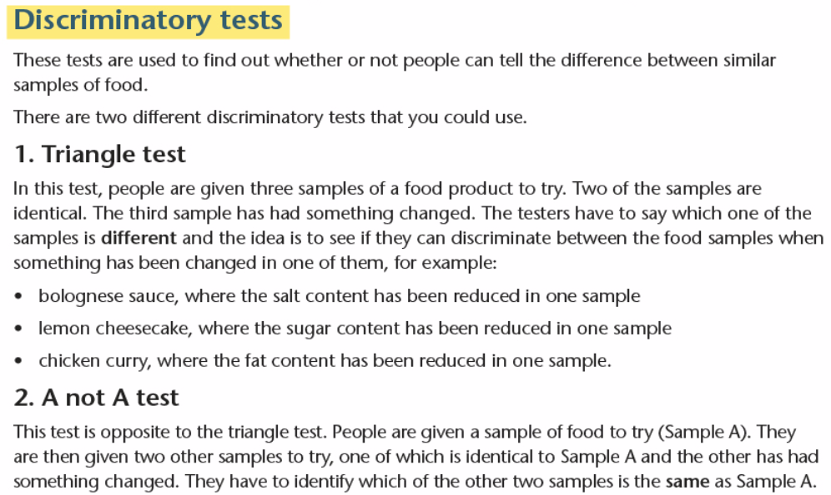
Section B: Possible testing

Slide 9
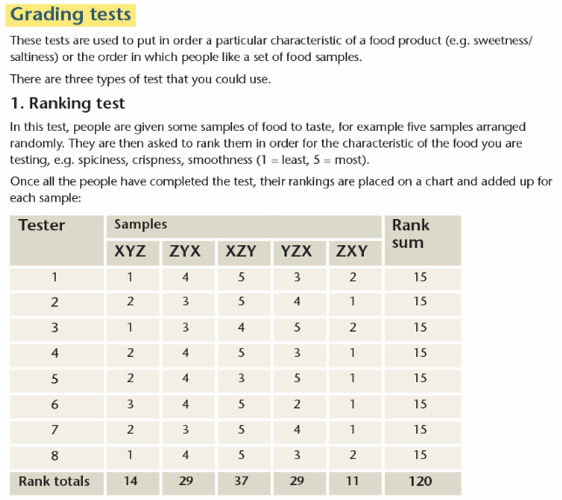
Section B: Possible testing

Slide 10
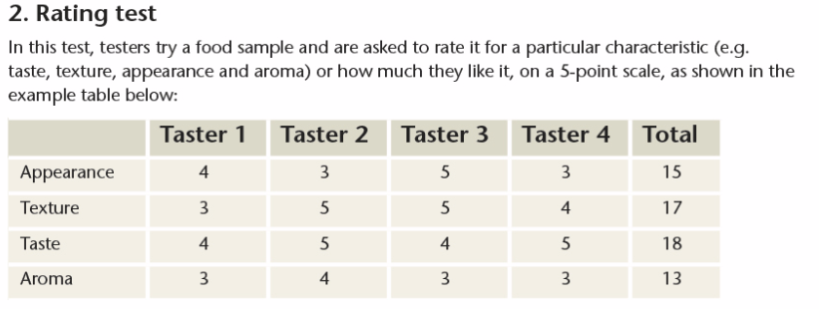
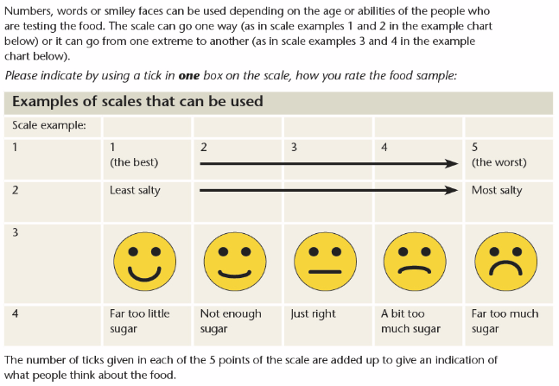
Section B: Possible testing

Slide 11
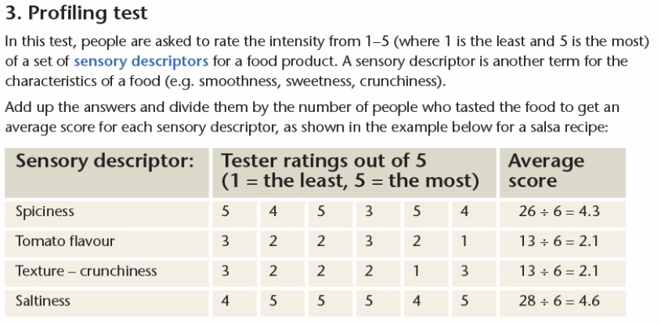
Section B: Possible testing

Slide 12
Section B: Tips for fair testing
On the following slide there is a range of advice as to how you could set up the testing of your practical experiments.
Use this (and the advice) to give reasons for the methods you have chosen when writing up your control methods and planning the practical work.
STOP

Slide 13
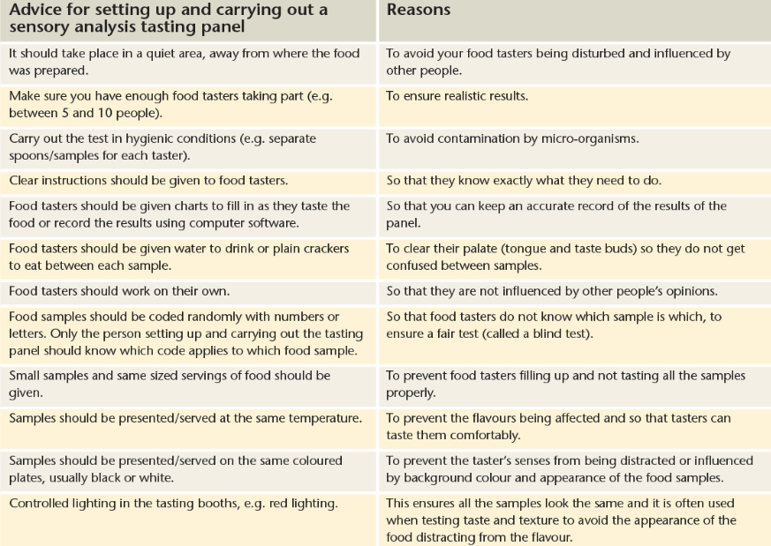
Section B: Tips for fair testing

Slide 14
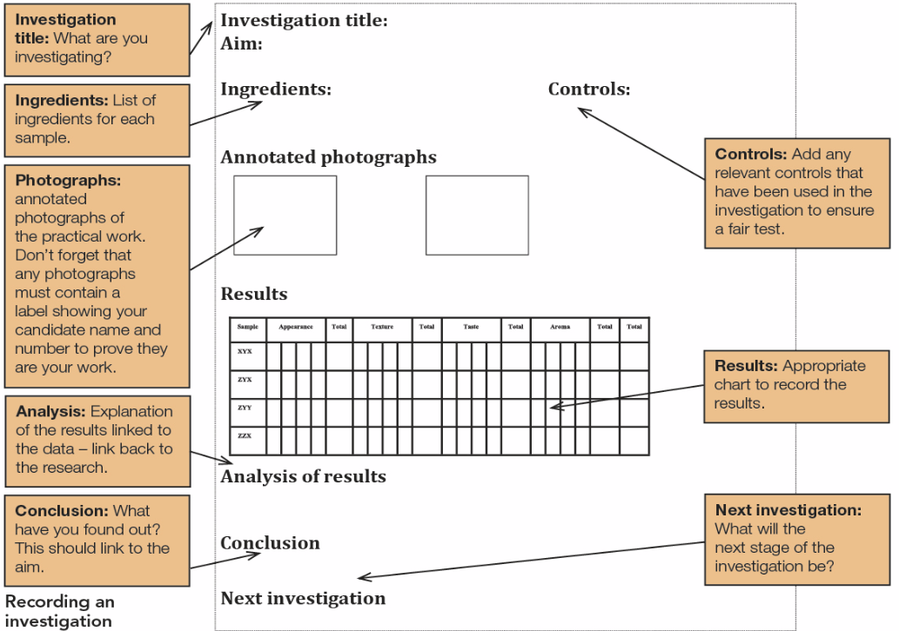
Section B: Possible Layout

Slide 15
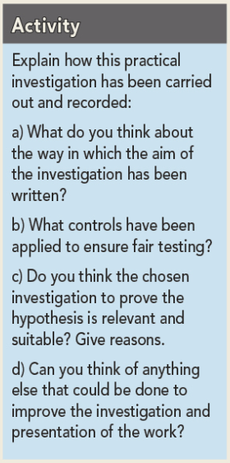
Section B: Example of practical investigation

