Slide 1


Year 11 – NEA Week 1
GCSE Food Preparation and Nutrition
NEA Task 1:
Food Investigation
An NEA is a Non-Exam Assessment
You have two of these to complete in Year 11
Task 1 – food investigation worth 15% of the overall mark
Task 2 – food preparation worth 35% of the overall mark
Share
Think
Pair

Slide 2
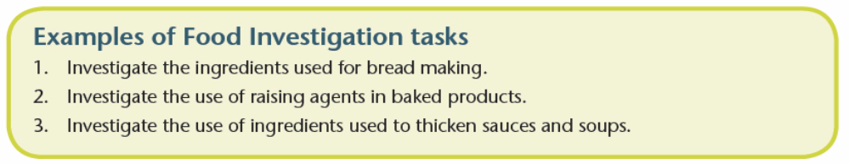

Year 11 – What does the NEA1 include?
You will investigate the working characteristics and the functional and chemical properties of a particular ingredient through practical investigation. You will produce a report which will research into ‘how ingredients work and why’
Outcome – written or electronic report including photographic evidence
Amount – between 1500-2000 words (6-8 sides of A4) – can be typed on a computer or written by hand
Time – not to exceed 10 hours
Content – individually record practical investigation and draw conclusions. Could include charts, graphs and diagrams. Good use of specialist terminology.
Student’s tips:
Try to present your work neatly. Language should be clear and use specialist terms where you can
Check spelling, punctuation and grammar (SPaG)
Use page space wisely – quality rather than quantity.

Slide 3
Year 11 – What does the NEA 1 include?
Section A: Research (6 marks) (2 hrs)
  Analyse the task explaining the background research
  Carry out research
  Analyse the research and use findings to plan the practical investigations
  Establish a hypothesis as a result of the research findings
Section B: Investigation (15 marks) (6 hrs)
  Practical investigations which demonstrate understanding of how ingredients work and why
  Record of results
  Use a range of appropriate testing methods – eg annotated photos, labelled diagrams, tables, charts, sensory testing methods, viscosity tests
Section C: Analysis and evaluation (9 marks) (2 hrs)
  Analyse and interpret results of investigations linked to research
  Evaluate the hypothesis with justification
  Explain how the results can be applied in practical food preparation and cooking
  A maximum of 10 hours

Slide 4
Plan of action – Time Line
Week | Lesson 1 | Lesson 2
1 | Intro, analysis of task and start research
2 | Research and Planning the investigations | Continue research and start planning Hand in research and planning notes
3 | Investigation 1 | Write up results and conclusion to investigation 1 Prepare Ingredients for practical 2 Make suggested changes to planning work
4 | Practical 2 Hand in Practical 1 write up | Write up results and conclusion to practical 2 Prepare Ingredients for practical 3
5 | Practical 3 Hand in Practical 2 write up | Write up results and conclusion to practical 3
6 | Final Analysis and Evaluation Hand in Practical 3 write up | Complete Analysis and Evaluation to hand in by Fri 20th Oct

Slide 5
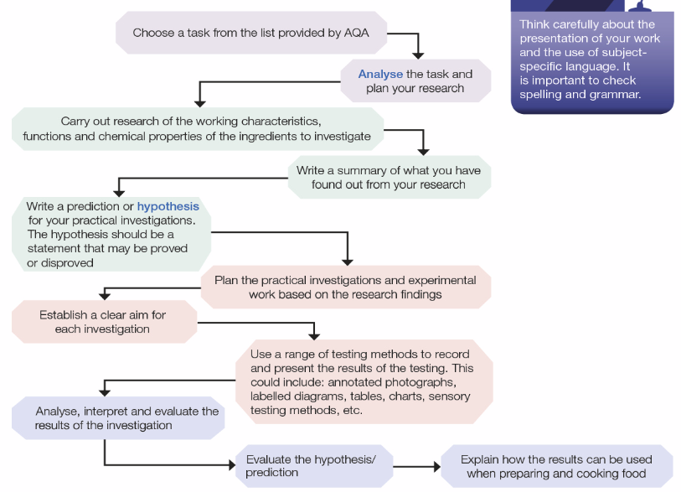
What do I need to do to complete the task?

Slide 6
In the NEA, the following information has to be included:
Year 11 – Content
Analysis of the task
Explanation of how the result will help you cook and prepare food in the future
Background research related to ingredients
Research conclusions
Hypothesis
Practical investigations x 3
Analysis of the investigations x 3
Testing of the results x 3
Recording of the results x 3
Explanation and justification of conclusion
Application of results in practical food preparation and cooking

Slide 7
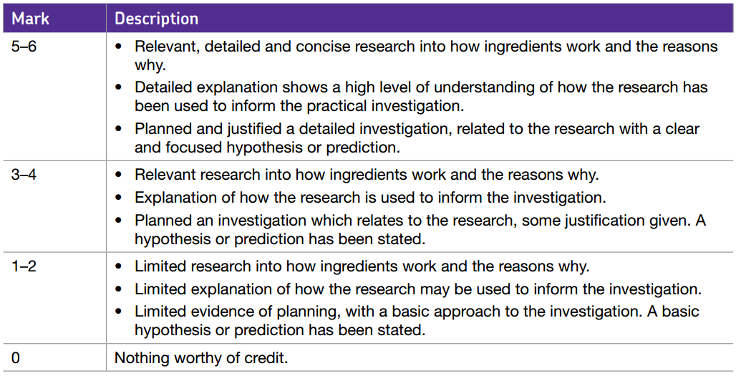
Learning Objectives- SECTION A: RESEARCH analyse the task, explaining the background research carry out secondary research, using different sources, focusing on the working characteristics, functional and chemical properties of the ingredients analyse the research and use the findings to plan the practical investigation establish a hypothesis/predict an outcome as a result of the research findings. The hypothesis should be a statement which may be proved or disproved.
 | Personalisation Special attention today goes to…
6

Slide 8
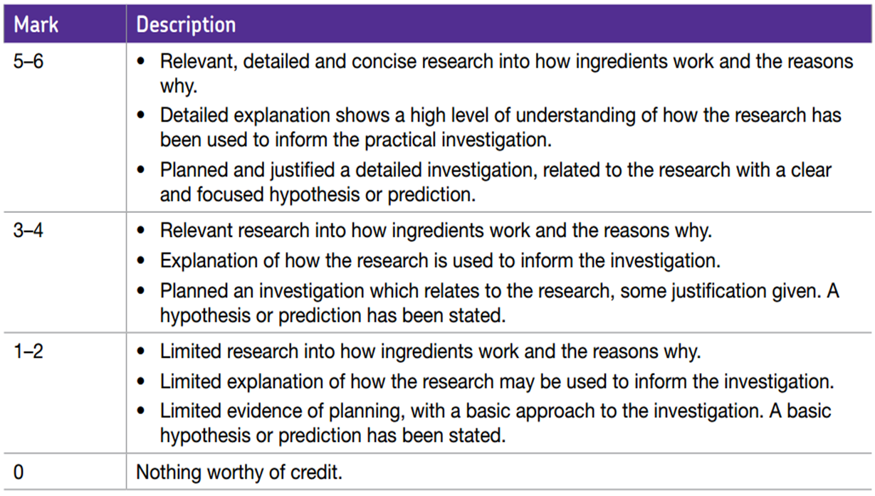
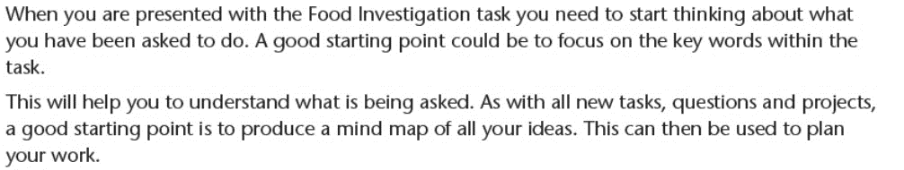

Analysing the Task
Section A: Research
Focus on the keywords within the task – what are these and what do they mean? Create a bubble diagram of ideas and points you could take forward to help you with your research.
Investigate the what type of flour is best for bread making?

Slide 9
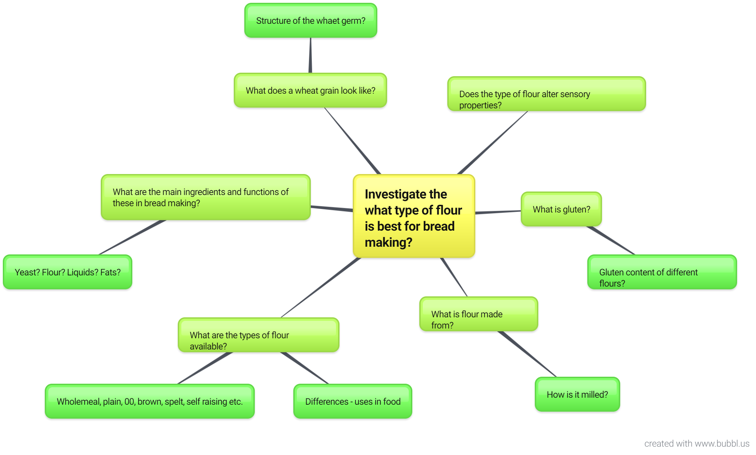
Section A: Research – Analysis of the Task
Example
Have you recorded all of your thoughts? Have you explored all aspects of the task?

Slide 10
Section A: Research – Methods
Research can be both primary and secondary
Primary – involves gathering data or information that has not been collected by other people and that you have designed an carried out yourself – eg surveys, interviews, questionnaires
  What can you do that would be primary research?
Secondary – involves gathering data or information that has already been produced – eg textbooks (don’t copy but put into your own words), websites (use reliable UK sites and again no copying and pasting), multimedia (watch videos from You Tube), using prior knowledge (from this course and any other relevant courses). All sources MUST be referenced
  What can you do that would be secondary research?

Slide 11
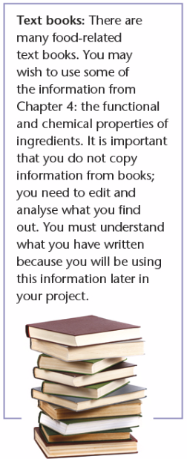



Section A: Research – Secondary Examples

Slide 12
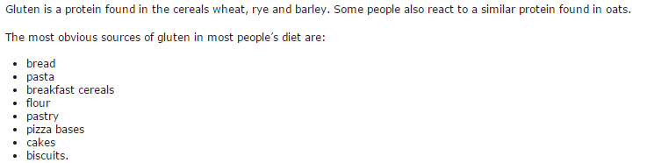
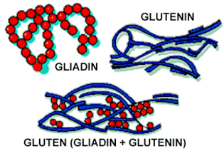
Section A: Research – Referencing your research
You must say where you found your research. You can do this by referencing the source.
For example you could refence your information within the document (see below) – or you could list your sources in a bibliography in the NEA appendix.
Ref: https://www.coeliac.org.uk/gluten-free-diet-and-lifestyle
Ref: Food Studies: What’s up with gluten?
By Mitchell Mattes Nov 11, 2011

Slide 13
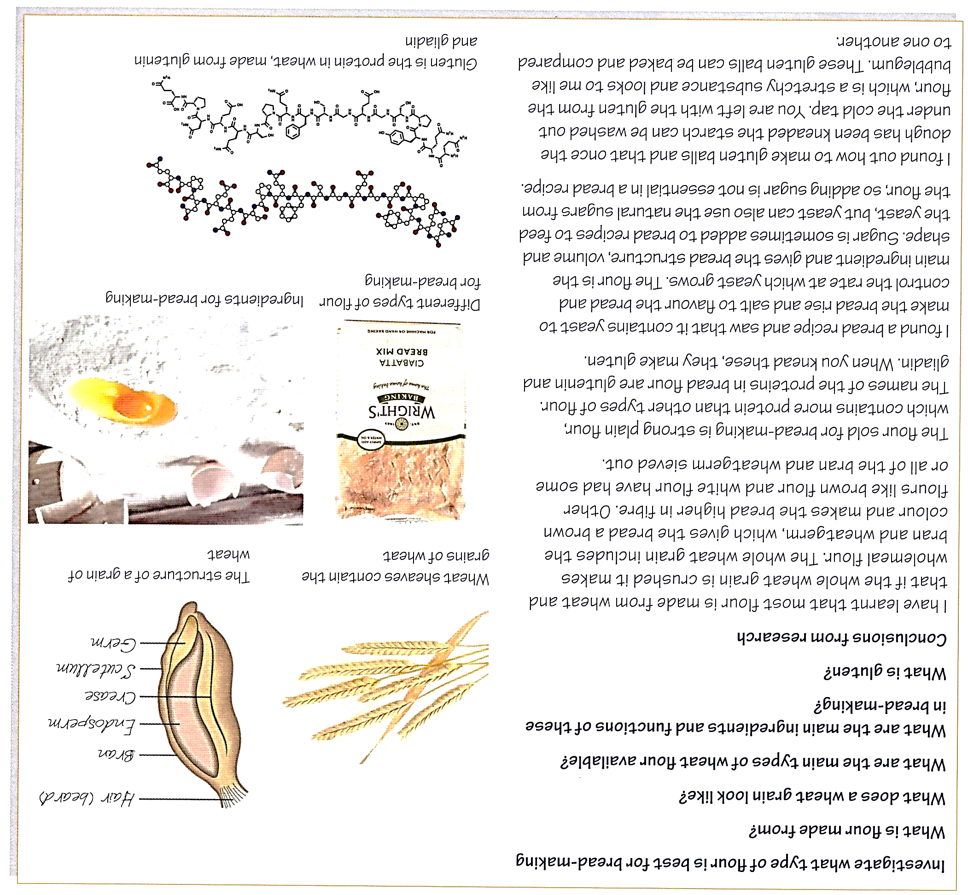
Section A: Research – Example
Task Analysed
Secondary Research
Analysing and Concluding – what you have found out? How does it help you to choose your practical focus?
Don’t forget the references!!

Slide 14
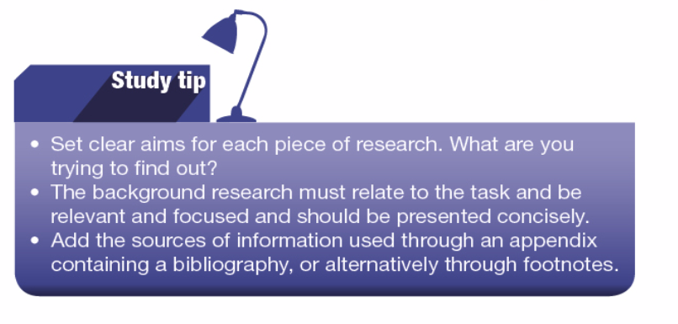
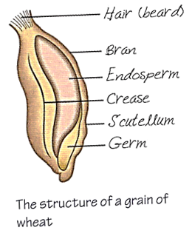
Section A: Research – Analysing the research
To complete the research you are trying to find information to answer your task analysis questions/bubble diagram.
It is very important that you summarise what you have found out within each piece of research you have carried out.
Stick to the point – say exactly what the information found tells you.
Example:
Aim: What is flour made from?
        “I learnt that most flour is made from wheat and that if the whole wheat grain is crushed it makes wholemeal flour. Wholemeal flour contains all of the bran from the grain of wheat – this would give the bread a brown colour and increase the fibre content. Other flours like white and brown have had some of the bran sieved out.”

Slide 15

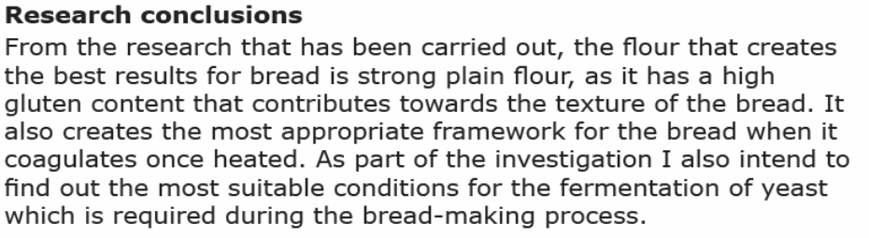
STOP
Remember – this NEA is meant to test you food science knowledge and your understanding of ingredients.
In your research analysis and conclusions have you given enough detail to show your knowledge?
Have you summarised what you have found?
Example:

Slide 16
Section A: Hypothesis
Once you have completed your research into how ingredients work, you will then need to decide on a hypothesis or predict an outcome for the investigation. You will test this through practical investigation and experimentation.
Example:
Hypothesis
My hypothesis is that the most successful flour for breadmaking is strong plain flour because it has a high protein (gluten) content.
or
Prediction
I predict that the best flour for bread-making will be the strong plain flour because this flour is also called bread flour and is made from harder wheats suited to bread making.
Think about !!
Look at the language used in the two statements above – to make your hypothesis/prediction clear you must refer back to knowledge you found in the research.

Slide 17

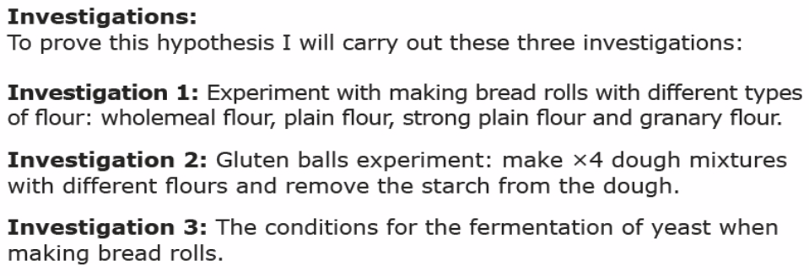
Section A: Research – Planning the Investigation
After deciding on a hypothesis/prediction, you can set you aims and plans ready for the actual practical investigation that will take place. A minimum of 3 investigations are needed.
The practical investigation is to test whether you predictions were correct or that you may find a different outcome.
From you conclusions develop a list of aims/investigation tasks. These break down the whole tasks into separate practical experiments.
Example:

